Slide 1
Computers Everywhere!
Computers in automobiles
Cell phones
Human genome project
World Wide Web
Search engines

Slide 2
Classes of Computing Applications
Personal Computers
Servers
Embedded Computers

Slide 3
Making a fast program before…
Minimize memory space to make programs fast
(not so simple!)
Notes:
If you are interested in old software development, search about: overlaying

Slide 4
Making a fast program today…
Understand the parallel nature of processors and the hierarchical nature of memories
Don’t forget about energy efficiency of programs

Slide 5
Some questions
How are programs written in a high-level language translated into the language of the hardware?
What is the interface between the software and the hardware?
What determines the performance of a program, and how can a programmer improve the performance?
What are the reasons for and the consequences of the recent switch from sequential processing to parallel processing?

Slide 6
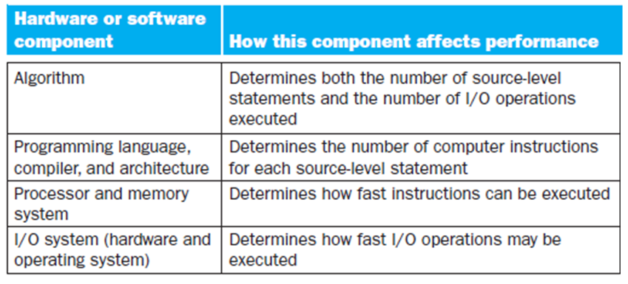
Understanding Program Performance

Slide 7
8 Great Ideas in Computer Architecture
Design for Moore’s Law
Use Abstraction to Simplify Design
Make the Common Case Fast
Performance via Parallelism
Performance via Pipelining
Performance via Prediction
Hierarchy of Memories
Dependability via Redundancy

Slide 8
From a High-Level Language to the Language of Hardware
Computer alphabet: ON and OFF
A really long sequence of 1s and 0s – Binary digits (or bits)
Human language: “Computer, please add A to B!”
Assembly language: “add A B”
Machine language: “1000110010100000”

Slide 9
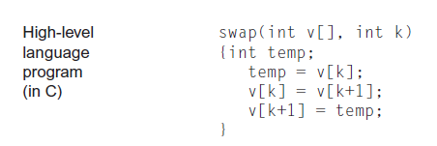
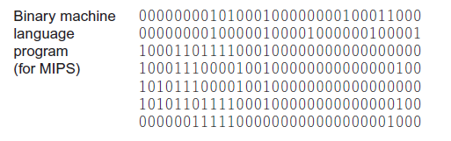
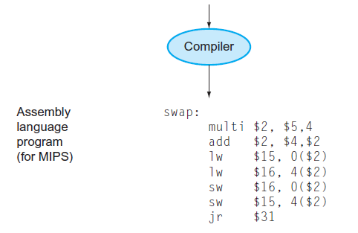
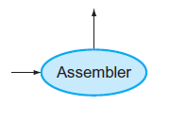

Slide 10
Why High-level languages?
There is one for every use!
Examples: Fortran was designed for scientific computation, Cobol for business data processing, Lisp for symbol manipulation, and so on.
Less lines for better ideas! (and less bugs)
Independence from the machine
Compilers and assemblers will do the trick!

Slide 11
Great, but what about the hardware?
The underlying hardware in any computer performs the same basic functions:
Inputting data
Outputting data
Processing data
Storing data

Slide 12
Great, but what about the hardware?
Two key components:
Input devices
Output devices

Slide 13
Great, but what about the hardware?
5 classic components:
Input
Output
Memory
Datapath
Control
The Processor

Slide 14
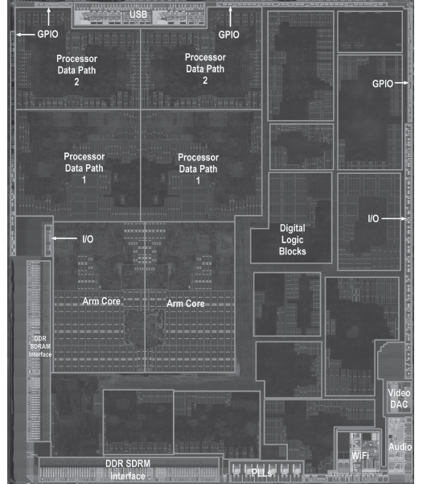
Apple A5 (iPad 2)
Two ARM processors that operate with a clock rate of 1 GHz. Also known as CPU, central processor unit.
Datapath and Control
The datapath performs the arithmetic operations, and control tells the datapath, memory, and I/O devices what to do according to the instructions of the program.

Slide 15
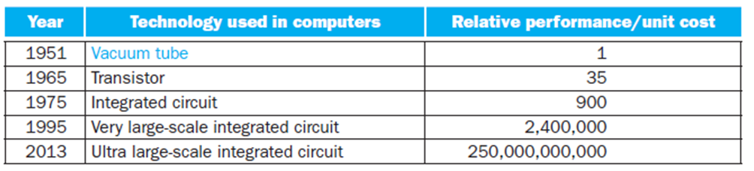
Technologies for Building Processors and Memory
A transistor is simply an on/off switch controlled by electricity. The integrated circuit (IC) combined dozens to hundreds of transistors into a single chip.

Slide 16
Technologies for Building Processors and Memory
To understand how manufacture integrated circuits, we start at the beginning:
A semiconductor: silicon
Special condition let it insulate or conduct electricity, a switch

Slide 17
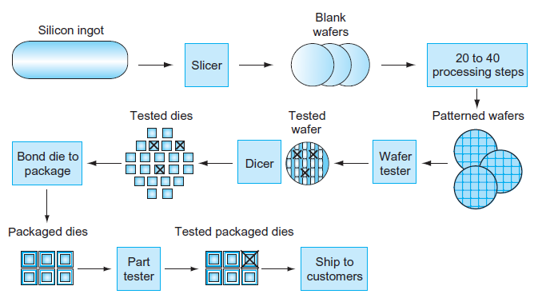

Slide 18
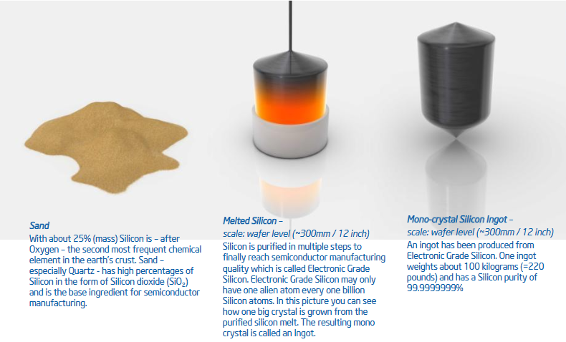

Slide 19
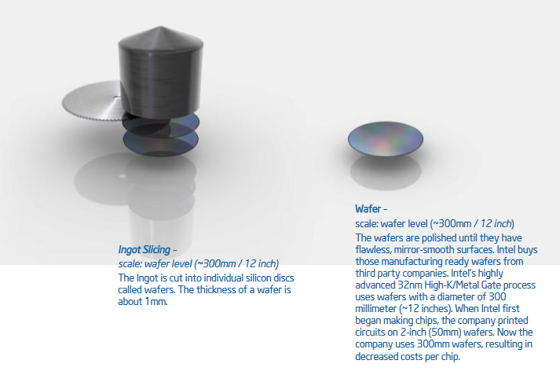

Slide 20
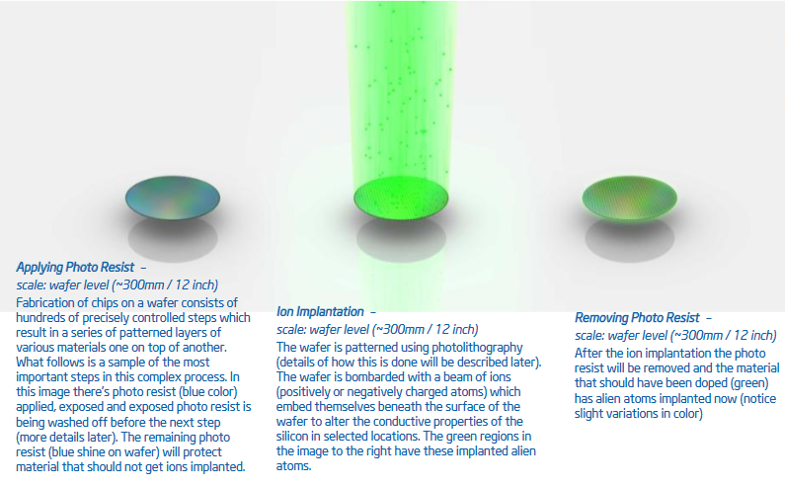
Notes:
Altering conductive properties

Slide 21
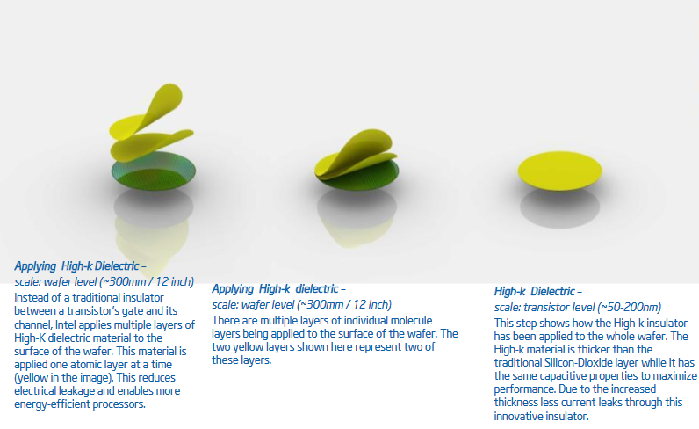
Notes:
Layers of Insulator

Slide 22
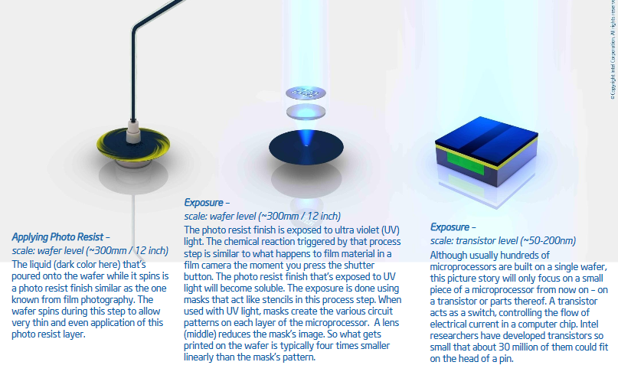
Notes:
Photo Lithography

Slide 23
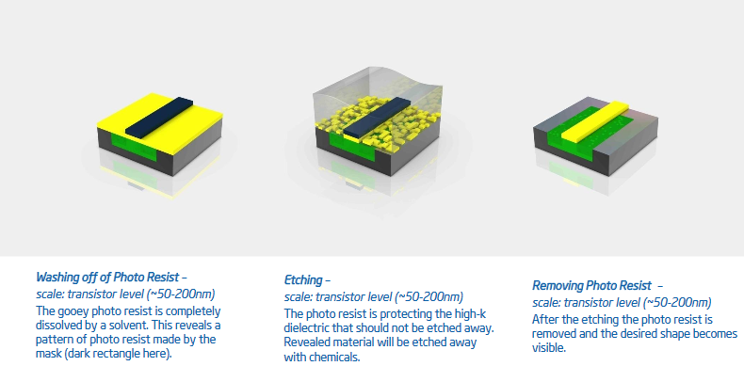
Notes:
Removing material

Slide 24
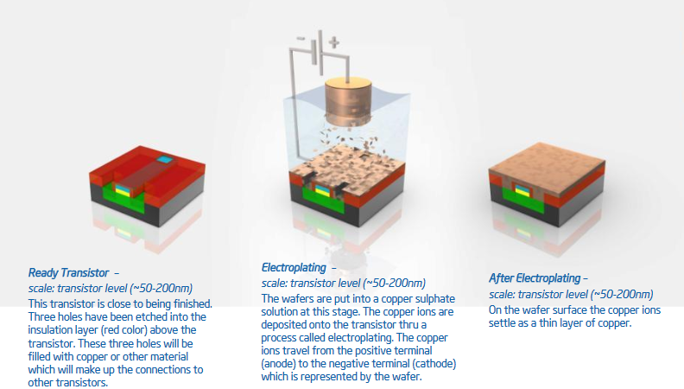
Notes:
Layer of copper

Slide 25
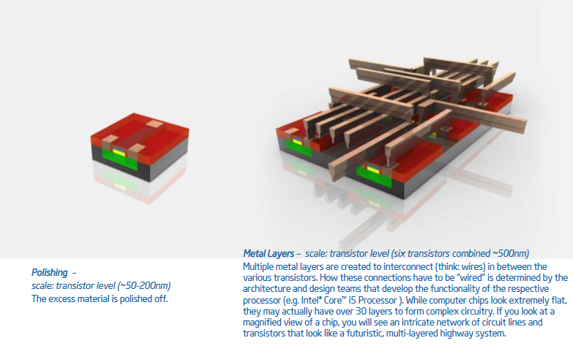
Notes:
Interconnection of various transistors

Slide 26
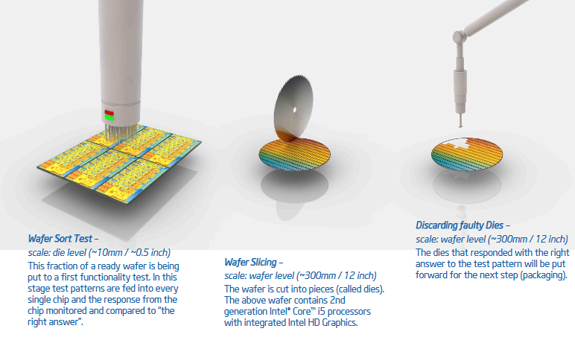

Slide 27
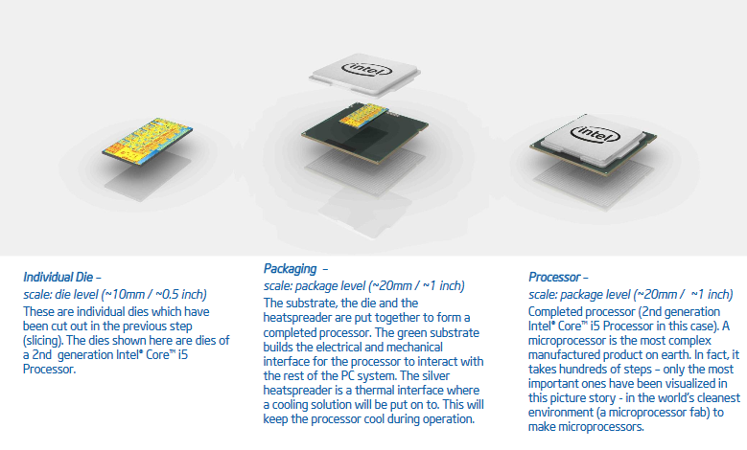

Slide 28
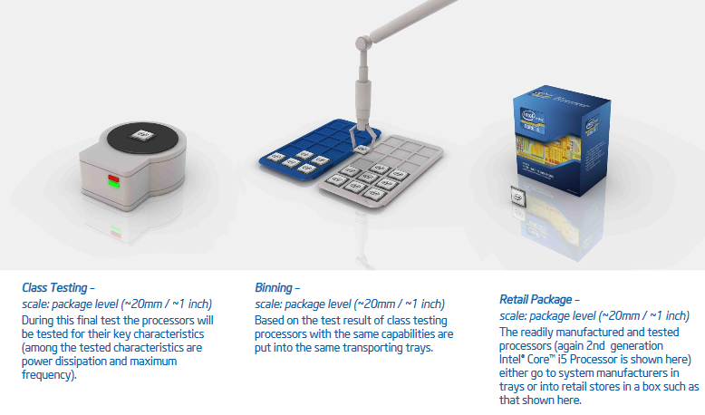

Slide 29
Measuring Performance
Wall clock time (aka, response time or elapsed time)
CPU Time

Slide 30


Measuring Performance
This formula makes it clear that the hardware designer can improve performance by reducing the number of clock cycles required for a program or the length of the clock cycle.

Slide 31

Measuring Performance
Formulas in term of Instruction count and Clock Cycles Per Instruction

Slide 32
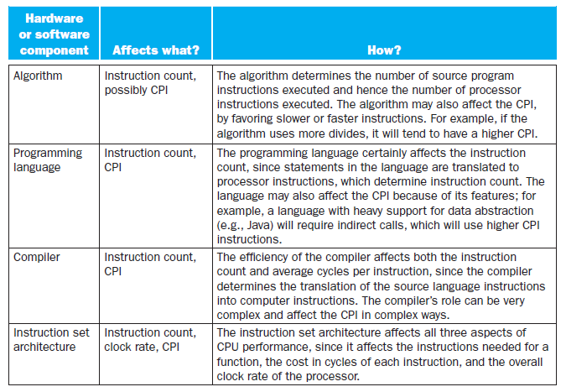

Slide 33
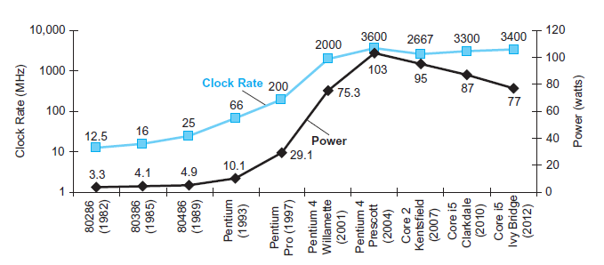
The Power Wall

Slide 34
Why has it been so hard for programmers to write parallel programs?
Performance in the first place.
Split the load among the cores.
Scheduling the splitting can make parallel programs slower than sequential ones!
Reduce communication and synchronization overhead.

